Slide 1
RECOMMENDER SYSTEM
Kevin Torres V.

Slide 2
What is a recommender system?
A recommender system or a recommendation system (sometimes replacing "system" with a synonym such as platform or engine) is a subclass of information filtering system that seeks to predict the "rating" or "preference" a user would give to an item.
Recommender systems are utilized in a variety of areas including movies, music, news, books, research articles, search queries, social tags, and products in general. There are also recommender systems for experts, collaborators, jokes, restaurants, garments, financial services, life insurance, romantic partners (online dating), and Twitter pages.

Slide 3

Introduction / Business problem
The objective of this project is to search in each of the neighborhoods to see where restaurants, joints and places are mainly concentrated to
analyze the possibilities of creating a warehouse where these establishments can be supplied.

Slide 4


Data that we are going to use
Basically, the data we need is geolocation information for a specific borough and neighborhoods.
When searching on Google, we get the latitude and longitude of a borough located in Toronto.
We will rely on part of the data we obtained in the previous weeks of this course.
Once we get all this 'basic' data, we will use the 'Foursquare' API to see in each neighborhood place and venue to make a more accurate analysis.

Slide 5
Get into the real problem

Slide 6
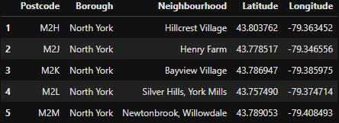
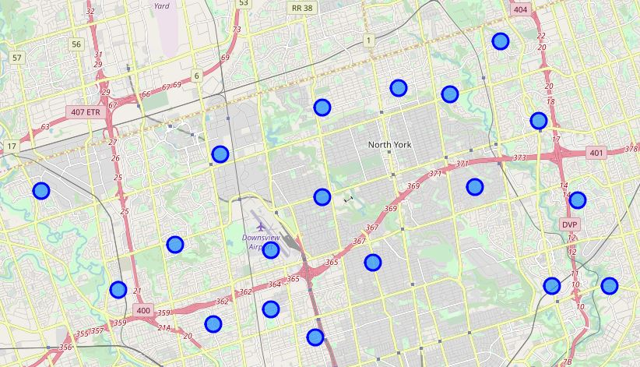
Select our Borough and identify its neighborhoods
Using the postal codes contained in the table obtained from Wikipedia (https://en.wikipedia.org/wiki/List_of_postal_codes_of_Canada:_M) we selected one of the boroughs to inspect their neighbourhoods. In this case we selected *North York*

Slide 7
Retrieving Data from 'Foursquare'
After getting a list of the neighborhoods in *North York*, we need to get access to the Foursquare API to retrieve information about each venue that is in *North York*. When delimiting the radius, we will look for information of venues located at 1000 meters from the center of the neighborhood.

Slide 8
Creating a DataFrame with pandas to store the processing data obtained from Foursquare
To facilitate the analysis, it is important to compile our data in a form that gives us a better perspective of the information we have just obtained. Once we have done this, the next step is to select a group of features to help us integrate "Restaurants", "Joints" and "Places" in a single DataFrame.
The reason to do all this, is to apply techniques like K-Means that helps us to select the best location.

Slide 9
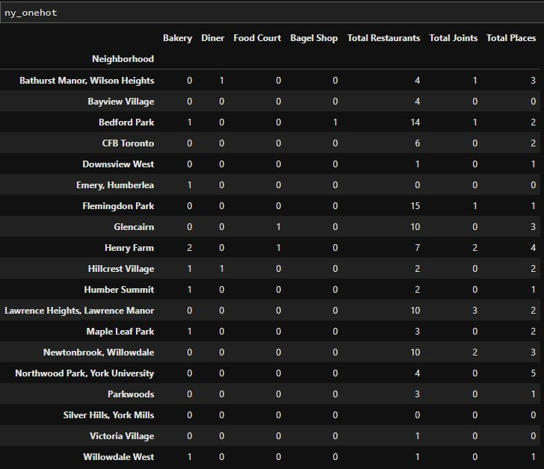

Slide 10
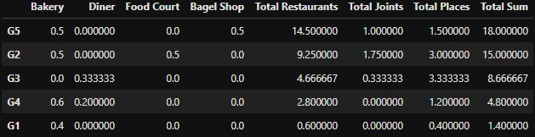
FINAL RESULTS
When inspecting the groups, we analyzed the results of *Total Restaurants*, *Total Joints* and *Total Places*. Then, the group where *Total Sum* is the highest, is the best group and so on for the following groups.

Slide 11
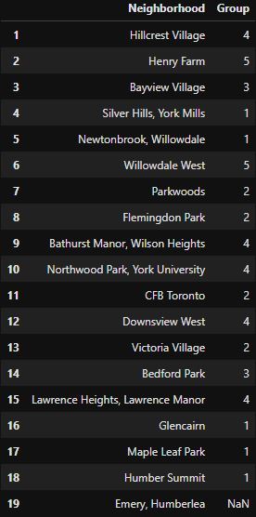
Assigning neighborhoods to their corresponding group

Slide 12
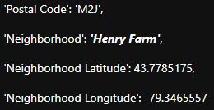
The best neighborhood that corresponds to group 5, is:

Slide 13
Thanks for watching this presentation, hope you liked it.

